Slide 1
Music features and lyrics
Jiayu wang

Slide 2
METHODOLOGY
Feature Selection
Topic Modelling
Random Forest

Slide 3
Feature selection
Use statistics for each feature(mean, variance, max, min, quantile)
Visualize the result of clustering to decide whether it is a significant feature
Remove features with high correlation
Features with 56 dimensions

Slide 4
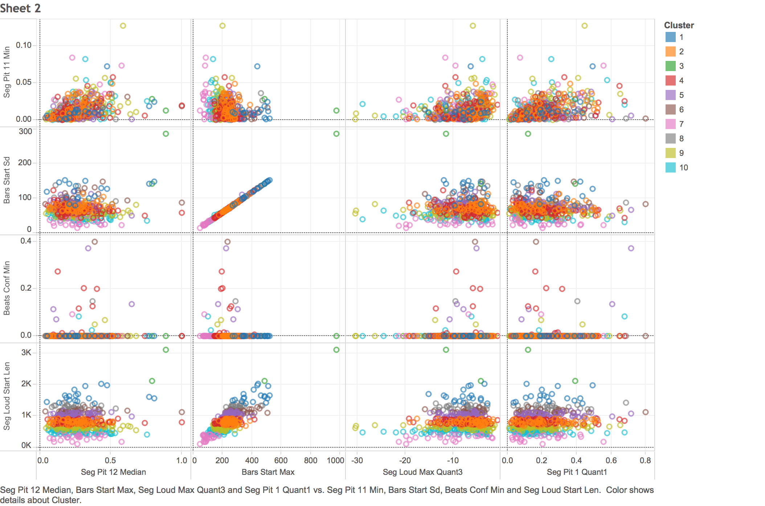
Feature selection and CLUSTERING

Slide 5
Topic modelling
Apply LDA algorithm on lyrics and classify it to 20 topics
For each song, sort the probability to decide which topic it belongs to
Add labels of topic to the music feature for doing random forest

Slide 6
Random forest classification
Divide data into training and testing data set to train parameters of random forest model
Using the best parameter achieved by cross-validation to train a final model
Use the final model to classify the topic label for new music features

Slide 7
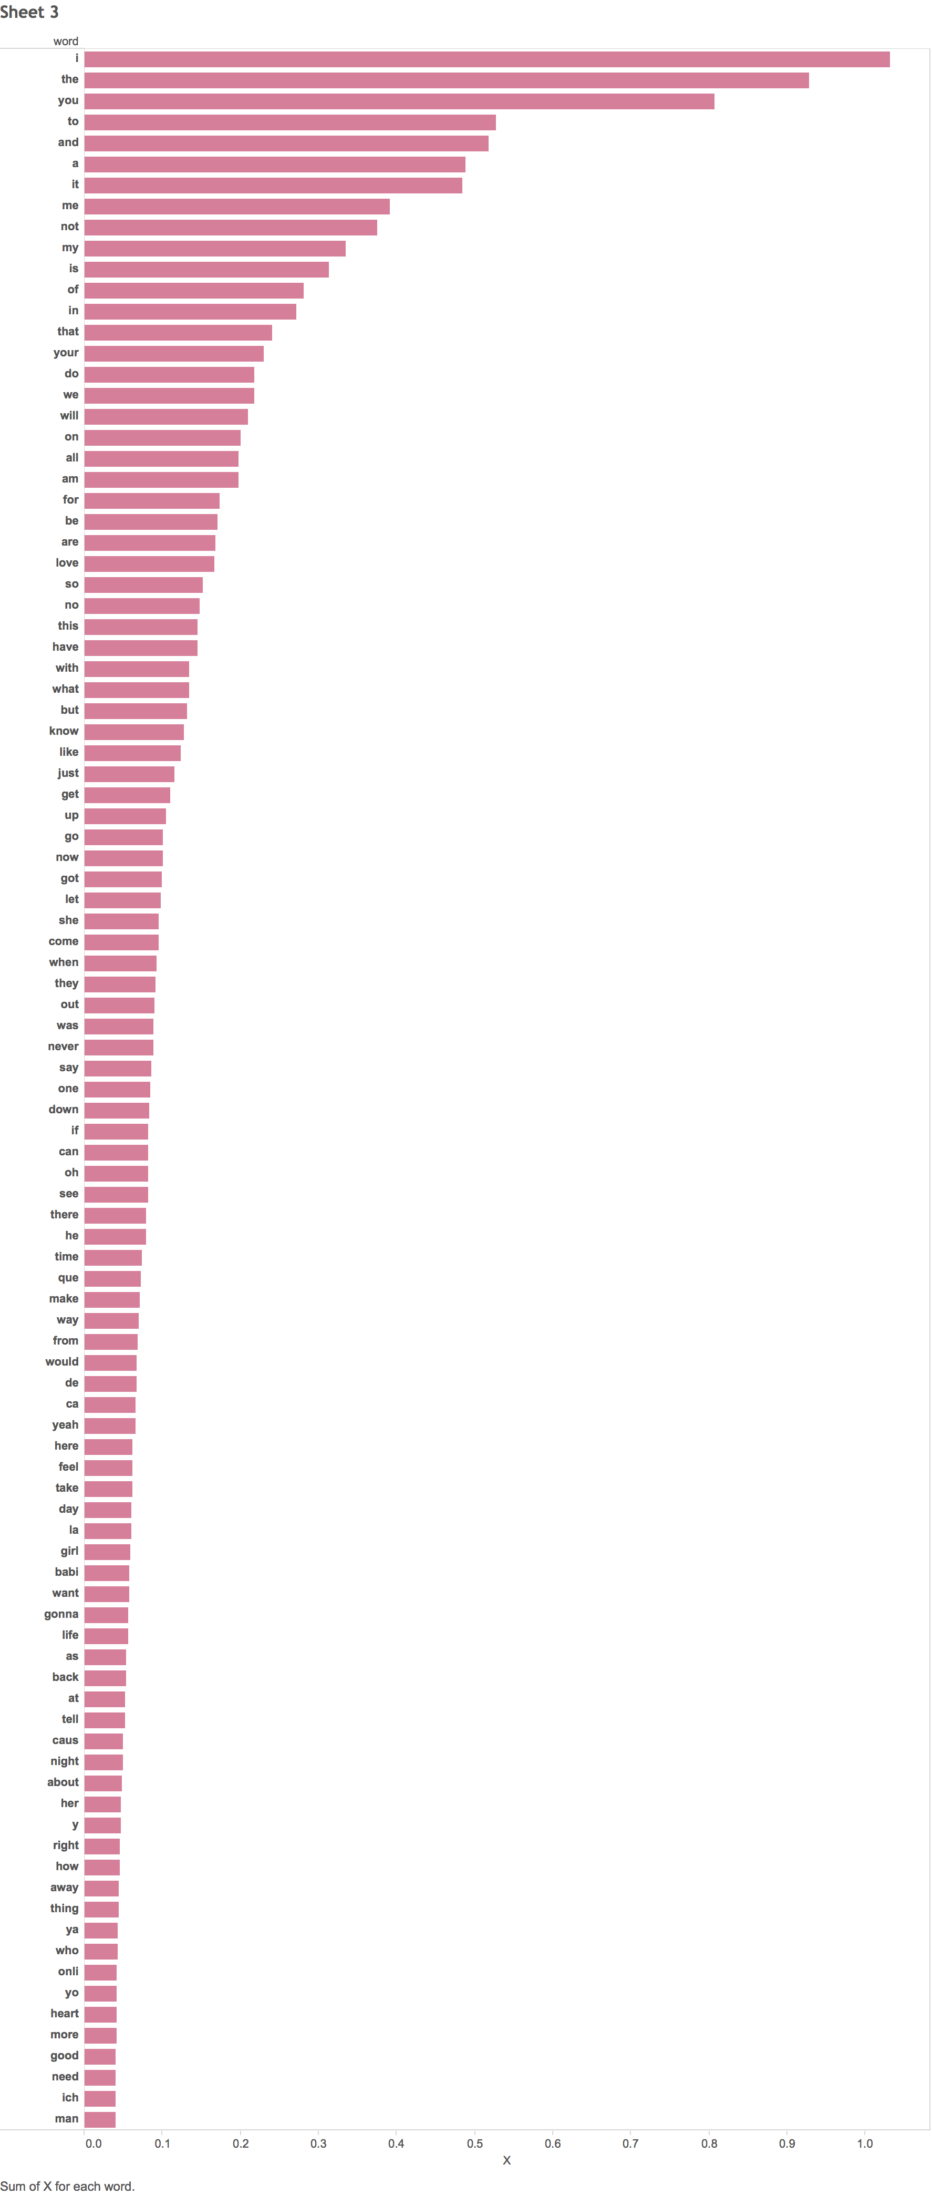
Word rank

